Slide 1
Being Ethical and Socially Responsible

Slide 2
Learning Objectives
Understand what is meant by business ethics.
Identify the types of ethical concerns that arise in the business world.
Discuss the factors that affect the level of ethical behavior in organizations.
Explain how ethical decision making can be encouraged.
Describe how our current views on the social responsibility of business have evolved.
Explain the two views on the social responsibility of business and understand the arguments for and against increased social responsibility.

Slide 3
Learning Objectives (cont’d)
Discuss the factors that led to the consumer movement and list some of its results.
Analyze how present employment practices are being used to counteract past abuses.
Describe the major types of pollution, their causes, and their cures.
Identify the steps a business must take to implement a program of social responsibility.

Slide 4
Business Ethics Defined
Ethics
  The study of right and wrong and of morality of the choices individuals make
  An ethical decision is one that is “right” according to some standard of behavior
Business ethics
  The application of moral standards to business situations

Slide 5
Ethical Issues
Fairness and honesty
  Businesspeople are expected to refrain from knowingly deceiving, misrepresenting, or intimidating others
Organizational relationships
  A businessperson should put the welfare of others and that of the organization above his or her own personal welfare
Conflict of interest
  Issues arise when a businessperson takes advantage of a situation for personal gain rather than for the employer’s interest
Communications
  Business communications that are false, misleading, or deceptive are both illegal and unethical

Slide 6
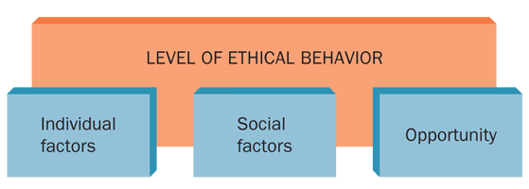
Factors Affecting Ethical Behavior
FIGURE 2-1
Source: Based on O. C. Ferrell and Larry Gresham, “A Contingency Framework for Understanding Ethical Decision Making in Marketing,” Journal of Marketing, Summer 1985, p. 89.

Slide 7
Factors Affecting Ethical Behavior (cont’d)
Three general sets of factors appear to influence the standards of behavior in an organization
  Individual factors
    Individual knowledge of an issue
    Personal values
    Personal goals
  Social factors
    Cultural norms
    Coworkers
    Significant others
    Use of the Internet
  Opportunity
    Presence of opportunity
    Ethical codes
    Enforcement

Slide 8
Encouraging Ethical Behavior
External to a specific organization
  Governmental legislation and regulations
  Trade association guidelines
Within an organization
  Code of ethics
    A written guide to acceptable and ethical behavior as defined by an organization; it outlines policies, standards, and punishments for violations
  Organizational environment
    Management direction
    Employee training
    Ethics officer
Whistle-blowing
  Informing the press or government officials about unethical practices within one’s organization

Slide 9
Guidelines for Making Ethical Decisions
1. Listen and learn. | Recognize the problem or opportunity; be sure you understand others.
2. Identify the ethical issues. | Examine how others are affected by the situation; understand the viewpoint of those involved in the decision or its consequences.
3. Create and analyze options. | Put aside strong feelings; come up with alternatives; assess which options offer the best results.
4. Identify the best option from your point of view. | Consider and test it against criteria such as respect, understanding, caring, fairness, honesty, and openness.
5. Explain your decision and resolve any differences that arise. | May involve arbitration or additional proposals.

Slide 10
Social Responsibility
The recognition that business activities have an impact on society and the consideration of that impact in business decision making
  Social responsibility costs money but is also
  good business
  How socially responsible a firm acts may affect the decisions of customers to do or continue to do business with the firm

Slide 11
The Evolution of Social
Responsibility in Business
Early 1900s: Caveat Emptor
  A Latin phrase meaning
  “let the buyer beware”
    What you see is what you get, and if it’s not what you expected, too bad
  Most people believed that competition and the marketplace would correct abuses
  The government became involved only in cases of obvious abuse

Slide 12
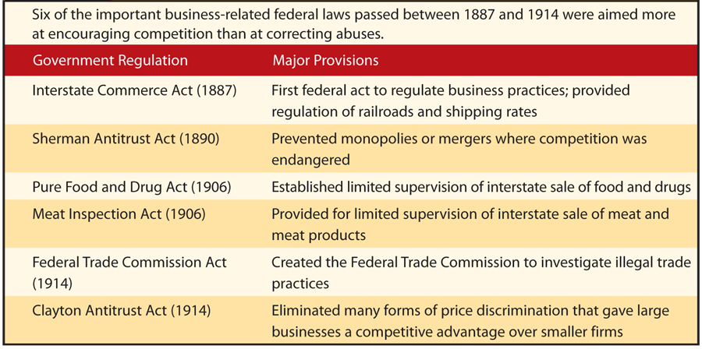
Early Government Regulations
Insert Table 2.2 from 9e, p.52

Slide 13
The Evolution of Social
Responsibility in Business (cont’d)
The Great Depression and beyond
  Pressure mounted for the government to help with the economy and social conditions
  Franklin D. Roosevelt instituted economic and social programs
  Laws were passed to correct business abuses
  As government has increased, so has everyone’s awareness of the social responsibility of business

Slide 14
Two Views of Social Responsibility
Economic model
  The view that society will benefit most when business is left alone to produce and market profitable products that society needs
  Managerial attitude: social responsibility is someone else’s job; the firm’s primary responsibility is to make a profit for its shareholders
  Firms are assumed to fulfill their social responsibility indirectly by paying the taxes that are used to meet the needs of society
  Social responsibility is the problem of government, environmental groups, and charitable foundations

Slide 15
Two Views of Social Responsibility (cont’d)
Socioeconomic model
  The concept that business should emphasize not only profits but also the impact of its decisions on society
  The corporation is a creation of society and it must act as any responsible citizen would
  Firms take pride in their social responsibility obligations
  It is in the best interest of firms to take the initiative in social responsibility matters

Slide 16
The Pros and Cons of Social Responsibility
Arguments for increased social responsibility:
  Because business is part of our society, it cannot ignore social issues.
  Business has the technical, financial, and managerial resources needed to tackle today’s complex social issues.
  By helping resolve social issues, business can create a more stable environment for long-term profitability.
  Socially responsible decision making by firms can prevent increased government intervention, which would force businesses to do what they fail to
  do voluntarily.

Slide 17
The Pros and Cons of
Social Responsibility (cont’d)
Arguments against increased social responsibility
  Business managers are primarily responsible to stockholders, so management must be concerned with providing a return on owners’ investments.
  Corporate time, money, and talent should be used to maximize profits, not to solve society’s problems.
  Social problems affect society in general, so individual businesses should not be expected to solve these problems.
  Social issues are the responsibility of government officials who are elected for that purpose and who are accountable to the voters for their decisions.

Slide 18
Consumerism
The Six Basic Rights of Consumers

Slide 19
Major Federal Legislation Protecting Consumers Since 1960
Federal Hazardous Substances Labeling Act (1960) | Warning labels on toxic household chemicals
Kefauver-Harris Drug Amendments (1962) | Drug testing and labeling for both generic and trade names
Cigarette Labeling Act (1965) | Warning labels on packages and ads
Fair Packaging and Labeling Act (1966) | Labels on products sold across states must include net wt, ingredients, and mfg name/address
Motor Vehicle Safety Act (1966) | Standards for safer cars
Truth in Lending Act (1968) | Finance charge disclosure in both dollars and annual percentage rates

Slide 20
Major Federal Legislation Protecting Consumers (cont’d)
Credit Card Liability Act (1970) | Card holder liability limited to $50 per card; unsolicited cards stopped
Fair Credit Reporting Act (1971) | Consumers can get credit reports and correct errors
Consumer Product Safety Commission Act (1972) | Established an abbreviated procedure for registering certain generic drugs
Fair Credit Billing Act (1974) | Consumer can challenge billing errors
Equal Credit Opportunity Act (1974) | Equal credit opportunities for males/females and single/married people
Magnuson-Moss Warranty-Federal Trade Commission Act (1975) | Minimum standards for written consumer warranties for products over $15

Slide 21
Major Federal Legislation Protecting Consumers (cont’d)
Amendments to Equal Credit Opportunity Act (1976, 1994) | Discrimination prohibited when granting credit
Fair Debt Collection Practices Act (1977) | Abusive collection practices by third parties outlawed
Nutrition Labeling and Education Act (1990) | FDA review of food labeling and packaging
Telephone Consumer Protection Act (1991) | Automated dialing and prerecorded-voice calling prohibited
Consumer Credit Reporting Reform Act (1997) | Credit issuers are responsible for accurate credit data
Children’s Online Privacy Protection Act (2000) | Parents control info collected from kids; commercial websites protect child info

Slide 22
Major Federal Legislation Protecting Consumers (cont’d)
Do Not Call Implementation Act (2003) | Directed the FCC and FTC to apply consistent rules on telemarketing
Credit Card Accountability, Responsibility, and Disclosure Act (2009) | Provided the most sweeping changes in credit card protections since the Truth in Lending Act of 1968
Dodd-Frank Wall Street Reform and Consumer Protection Act (2010) | Improved accountability and responsibility in the financial system; established a Consumer Financial Protection Agency

Slide 23
Employment Practices
The last five decades have seen progress toward affirming the rights of employees to equal treatment in the workplace
  Minority
    A racial, religious, political, national, or other group regarded as different from the larger group of which it is a part and that is often singled out for unfavorable treatment
A number of anti-discrimination laws were passed in the 1960s and 1970s but abuses
still exist

Slide 24
Employment Practices (cont’d)
Affirmative Action Programs
  Plans designed to increase the number of minority employees at all levels within an organization
  Objective is to ensure that minorities are represented in the organization in approximately the same proportion as the surrounding community
  Written plans are required for employers with federal contracts of more than $50,000 per year
  Problems arise from the use of quotas and charges of reverse discrimination
  Equal Employment Opportunity Commission (EEOC)
    The federal agency empowered to investigate complaints of employment discrimination and to sue firms that practice it

Slide 25
Employment Practices (cont’d)
Training programs for the hard-core unemployed
  Hard-core unemployed
    Workers with little education or vocational training and a long history of unemployment
  National Alliance of Business (NAB)
    A joint business-government program to train the hard-core unemployed

Slide 26
Concern for the Environment
Pollution
  The contamination of water, air, or land through the actions of people in an industrialized society
Environmental Protection Agency (EPA)
  The federal agency charged with enforcing laws affecting the environment
Safeguarding the environment requires
  Environmental legislation
  Voluntary compliance
  EPA enforcement actions

Slide 27
Major Environmental Laws
National Environmental Policy Act (1970) | Established EPA to enforce federal environmental laws
Clean Air Amendment (1970) | Automotive, aircraft, and factory emission standards
Water Quality Improvement Act (1970) | Strengthened water regulations; provided for large fines
Resource Recovery Act (1970) | Enlarged solid-waste disposal program; EPA enforcement
Water Pollution Control Act Amendment (1972) | Standards for cleaning navigable waters; elimination of harmful waste disposal by 1985
Noise Control Act (1972) | Standards for major sources of noise; EPA advises FAA on standards for planes
Clean Air Act Amendment (1977) | New deadlines for cleaning up polluted areas; review of existing air quality standards

Slide 28
Major Environmental Laws (cont’d)
Resource Conservation and Recovery Act (1984) | Federal regulation of potentially dangerous solid-waste disposal
Clean Air Act Amendment (1987) | National air-quality standard for ozone
Oil Pollution Act (1990) | Expanded oil spill prevention and response activities; established the Oil Spill Liability Trust Fund
Clean Air Act Amendments (1990) | Motor vehicles must be equipped with onboard systems to control about 90% of refueling vapors
Food Quality Protection Act (1996) | Required a new safety standard (reasonable certainty of no harm) for all pesticides used on foods
American Recovery and Reinvestment Act (2009) | $7.22 billion to EPA to protect/ promote “green” jobs, healthier environment

Slide 29
Concern for the Environment (cont’d)
Water pollution
  Water quality has improved in recent years, but high levels of toxic pollutants are still found in some waters
  Pollutants threaten the health of both people
  and wildlife
  Cleanup is complicated and costly because of
  runoff and toxic contamination
  Acid rain from sulfur emissions of industrial smokestacks is contributing to the deterioration of coastal waters, lakes, and marine life

Slide 30
Concern for the Environment (cont’d)
Air pollution
  Aviation emissions of carbon dioxide in the upper atmosphere are contributing to global warming
  Carbon monoxide and hydrocarbons emitted by motor vehicles and smoke and other pollutants emitted by manufacturing plants can be partially eliminated through pollution-control devices
  Weather and geography can contribute to air pollution

Slide 31
Concern for the Environment (cont’d)
Land pollution
  Fundamental issues are how to restore damaged or contaminated land and how to protect unpolluted land from future damage
  Problem is worsening because technology produces chemical and radioactive waste
  There is a shortage of landfill space for waste disposal
  Incinerators help solve the landfill shortage problem, but they produce toxic ash
  Other causes of land pollution include strip-mining, nonselective cutting of forests, development of agriculture land for housing and industry
  The EPA has been criticized for its handling of the $1.6 billion Superfund created in 1980 by Congress

Slide 32
Concern for the Environment (cont’d)
Noise pollution
  Excessive noise can do physical harm
  Ways to reduce noise levels
    Isolating the source of the noise
    Modifying machinery and equipment
  If noise cannot be reduced, workers can be protected by wearing noise-reduction gear

Slide 33
Who Should Pay for a Clean Environment?
Governments and businesses spend billions annually
to reduce pollution
Much of the money required is supposed to come from already depressed industries
A few firms have discovered it is cheaper to pay a fine than to install equipment for pollution control
Many business leaders say tax money should be used because business is not the only source of pollution
Environmentalists say the cost is an expense of doing business
Consumers will probably pay a large part of the costs—either as taxes or in the form of higher prices

Slide 34
Implementing a Program of
Social Responsibility
Developing a program of social responsibility
  Secure the commitment of top executives
  Plan the program
  Appoint top-level executive as director to implement the plan
  Prepare a social audit
    A comprehensive report of what the organization has done and is doing with regard to social issues that affect it
Funding the program
  Pass program costs on to consumers as higher prices
  Absorb the program costs as a business expense
  Seek tax reductions or other incentives

